Slide 1

January 3, 2022│ Ann Arbor MI
Build a Simple Steganography App with Python
Rick Weitzel
Ann Arbor, MI
Disclosures: none

Slide 2
Overview: Presentation Outline
Steganography is the art of hiding a secret message in plain sight.
Python to encode written messages into the pixels of a picture
No perceptible change in the picture
Recipient, who has the software, can extract the message
Use Voila to turn the Jupyter notebook into a basic but user-friendly application

Slide 3
Objectives: Why do we want to do this?
Note: this is NOT a difficult algorithm to crack and not intended to transmit confidential or sensitive information. It is intended for fun and learning basic data types and exploring image formatting. It might help you throw off those pesky AI tracking algorithms ☺
Do you remember passing notes in class as child? Or secret decoder rings?
Will sending puppy pictures pics lead to advertisements about dogfood? Pics of trees lead to landscaping ads?
How do I get rid of the annoying health ads or offers to refinance my home?
Learn about data types and coding and have fun.

Slide 4
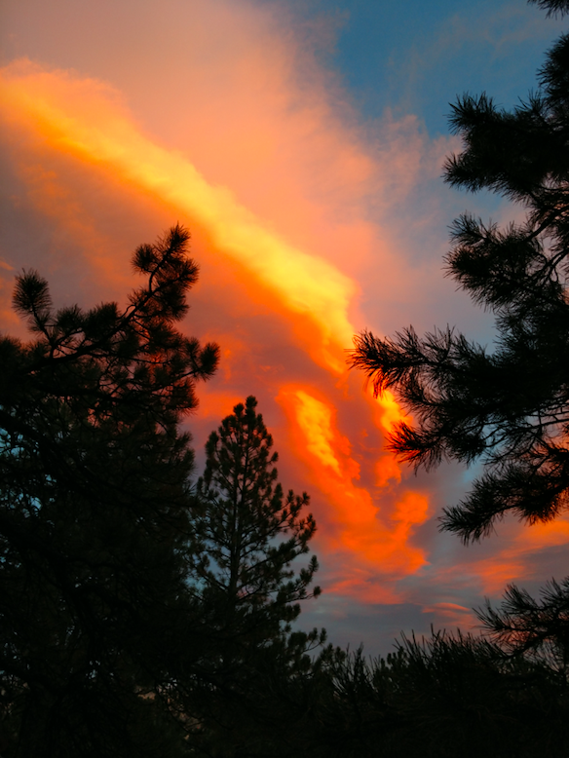
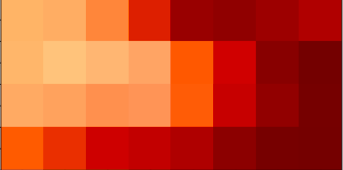
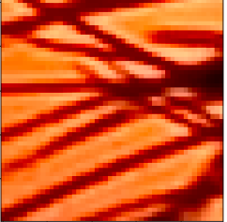
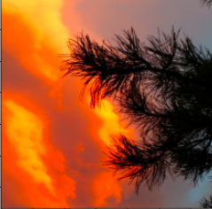
Overview: pick a picture (sunset)

Slide 5
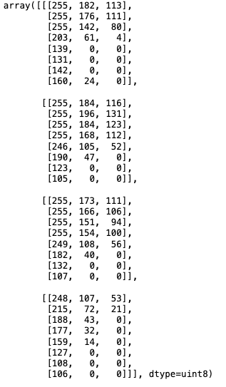
Overview: examine the pixels
Row 1
Row 2
Row 3
Coding Demo
Row 4

Slide 6
Program pseudo-code (func library)
Functions for encoding message into image:
convert message string to binary string: convert
Turn image into 1D vector and extract the section where the message will be inserted: prepare_carrier_segment
Insert message into carrier_segment: insert_message
Insert coded carrier segment into the 1D image vector: insert_coded_segment
Reshape the 1D coded image array including the message back into the image: get_coded_image
Functions for decoding message from image:
Get coded segment from coded_image: get_coded_image_segment
Extract the binary message from the coded image segment: extract_binary_message
Convert the binary message back to string: convert_back

Slide 7
Program pseudo-code (UI for App)
Encoding:
Select the image you want to use
Enter message for encoding
Put in parameters needed for encoding
Start location (different ways ways: random or selection number)
Need message length for this algorithm
Save the coded image to send to recipient
Parameters for decoding can be sent separately
Decoding:
Select Image you want to decode message from
Enter parameters and to decode massage

Slide 8
Using voila for the App
Voila – from pypi, readthedocs and other sources:
Voila turns jupyter notebooks into web applications, converts the notebook into an interactive dashboard
Voila uses “tornado” (application that launches a dedicated Jupyter kernel). The app can then execute jupyter interactive widgets from the web UI without showing the underlying code blocks.
Intended for sharing your notebook with users who do not need or do not want the code.
Resources:
https://pypi.org/project/voila/
https://voila.readthedocs.io/en/stable/
https://blog.jupyter.org/and-voil%C3%A0-f6a2c08a4a93

Slide 9
Conclusions
Explored image datatypes
Converted message and image data back and forth between data types using basic python commands: ord, chr, and format (‘08b’) functions.
Used binary representation image pixels and messages to (1) encode and (2) decode text messages by altering the least significant bit of the image.
Compared the images with and without coded message. They are visually the same but have slightly different underlying data (shifted last bit up/down).
Used Voila and Jupyter widgets for a UI for the user.

Slide 10
References / Resources
PIL
https://pypi.org/project/Pillow/
Matplotlib
https://matplotlib.org/
Numpy
https://numpy.org/
Project Jupyter and voila
https://jupyter.org/
https://pypi.org/project/voila/
https://voila.readthedocs.io/en/stable/
https://blog.jupyter.org/and-voil%C3%A0-f6a2c08a4a93
Code demo for today’s talk
https://github.com/resrch/MI_Python_20220203

Slide 11
Thank
You

Slide 12
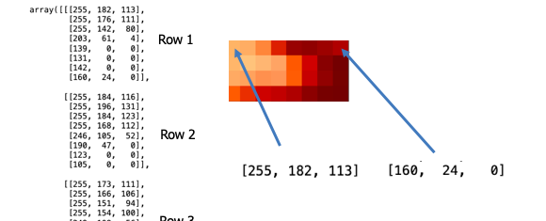
Overview: slide for presentation

